Slide 1
Building R Project for Data Visualization
Prepared by: Marwan Al Farah
Presented to: Dr. Rami Ibrahim

Slide 2
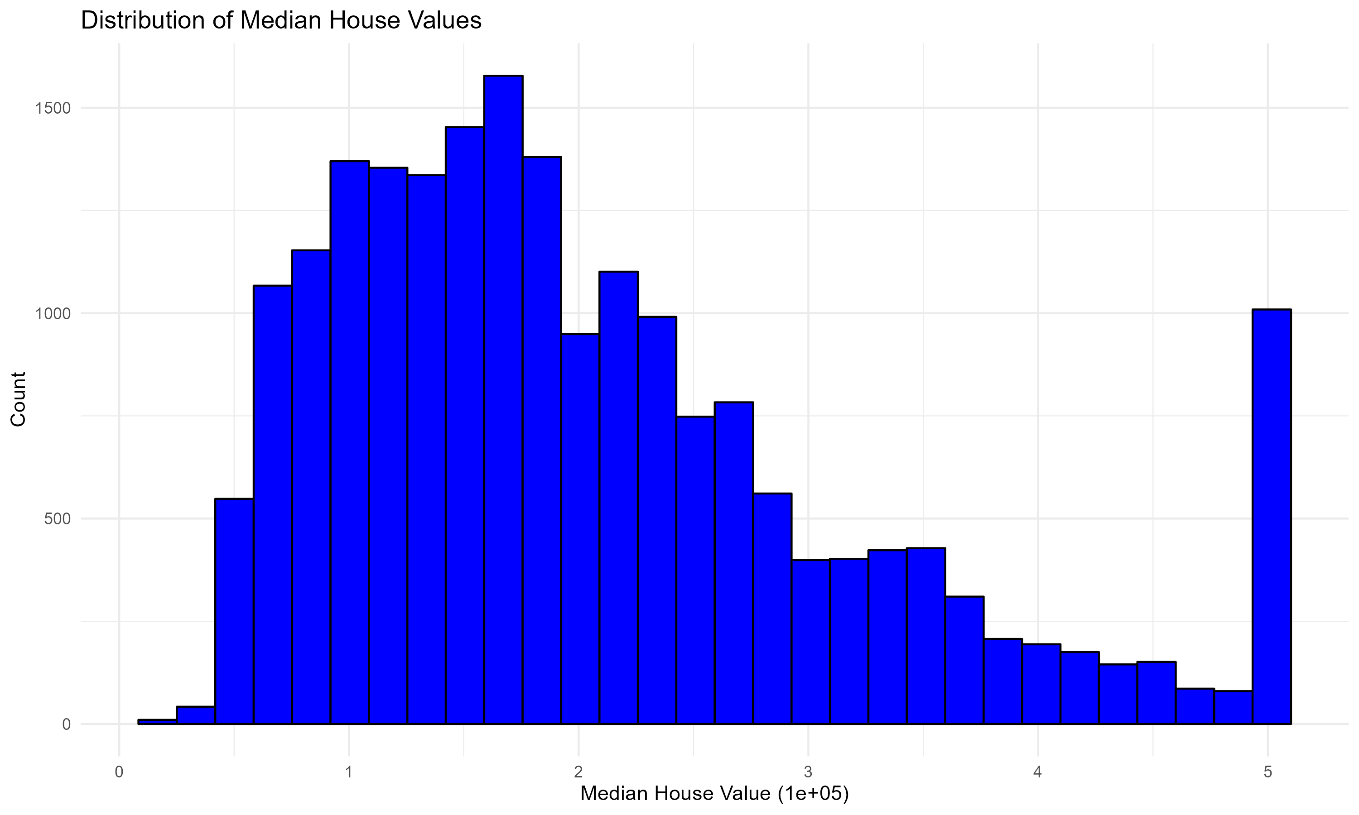
Histogram of Median House Values
Displays the distribution of median house values.
Most houses have values below $300,000, with a spike at $500,000, indicating a potential price cap.
Helps identify market trends and potential price limits, valuable for real estate agents and investors.

Slide 3
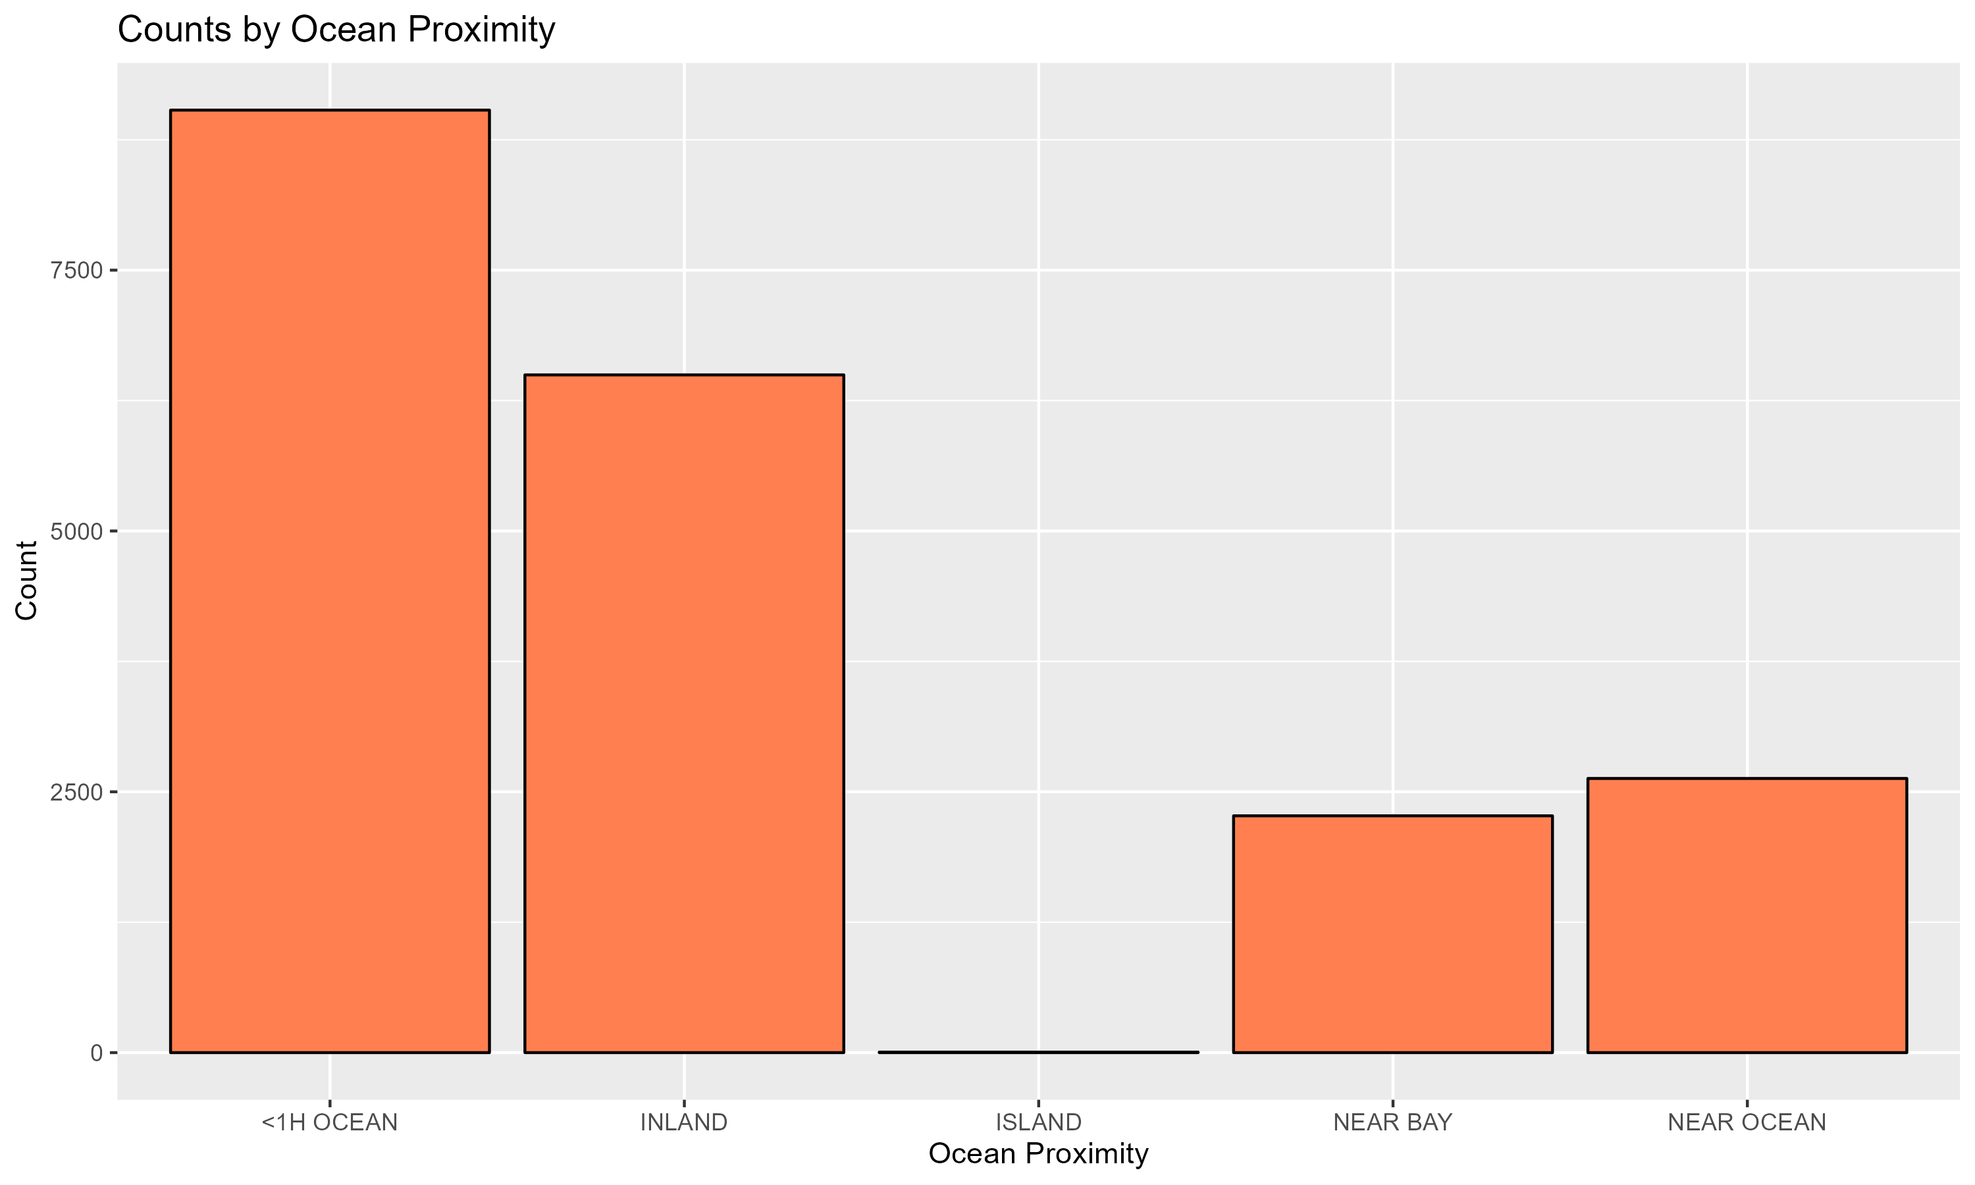
Bar Chart of Ocean Proximity Counts
Shows the count of houses by their proximity to the ocean.
Most houses are inland or within one hour of the ocean, with few on islands.
Guides real estate developers and investors in targeting specific markets based on proximity to the ocean.

Slide 4
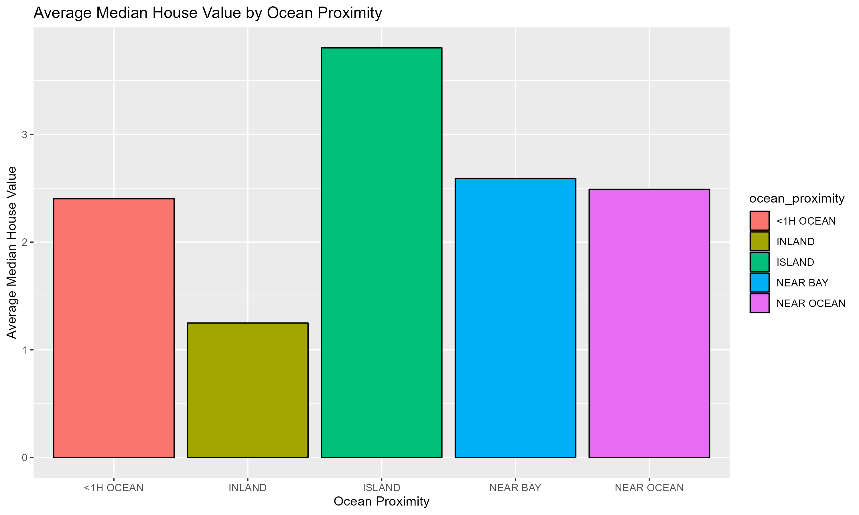
Average Median House Value by Ocean Proximity
Compares average house values based on ocean proximity.
Island properties have the highest values, followed by houses near the bay and ocean, with inland properties having the lowest values.
Informs pricing strategies and investment decisions by highlighting the value impact of ocean proximity.

Slide 5
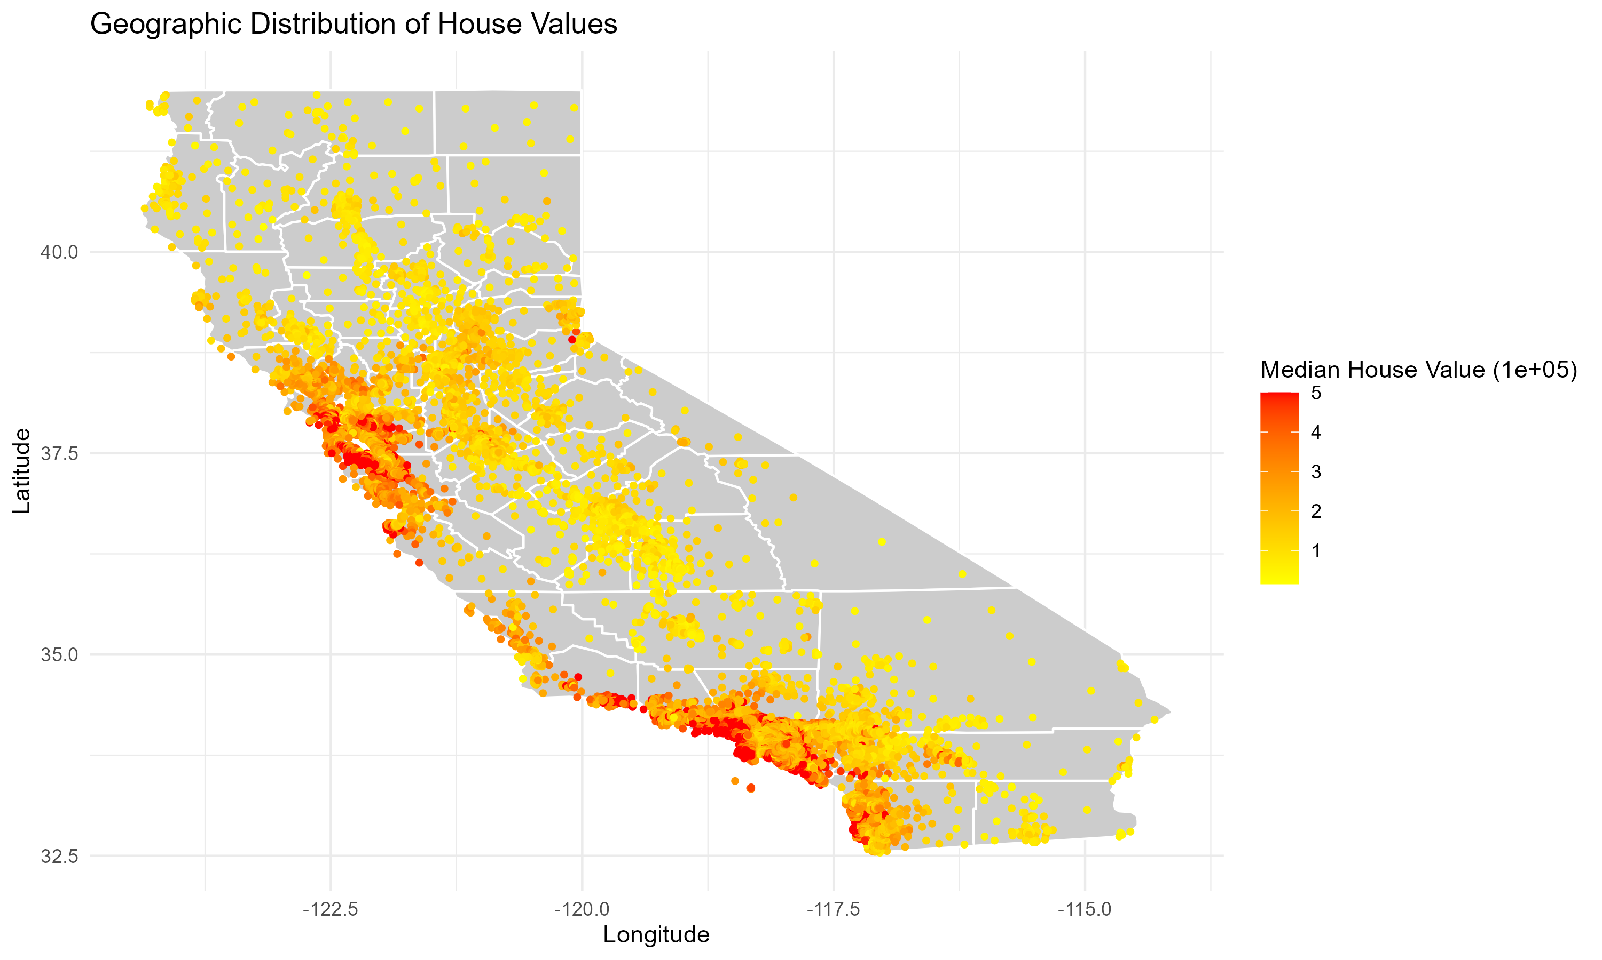
Geographic Heat Map of House Values
Shows the geographic distribution of house values across California.
Higher values are concentrated along the coast and in cities like Los Angeles and San Francisco.
Identifies high-value areas, guiding real estate investments and urban planning.

Slide 6
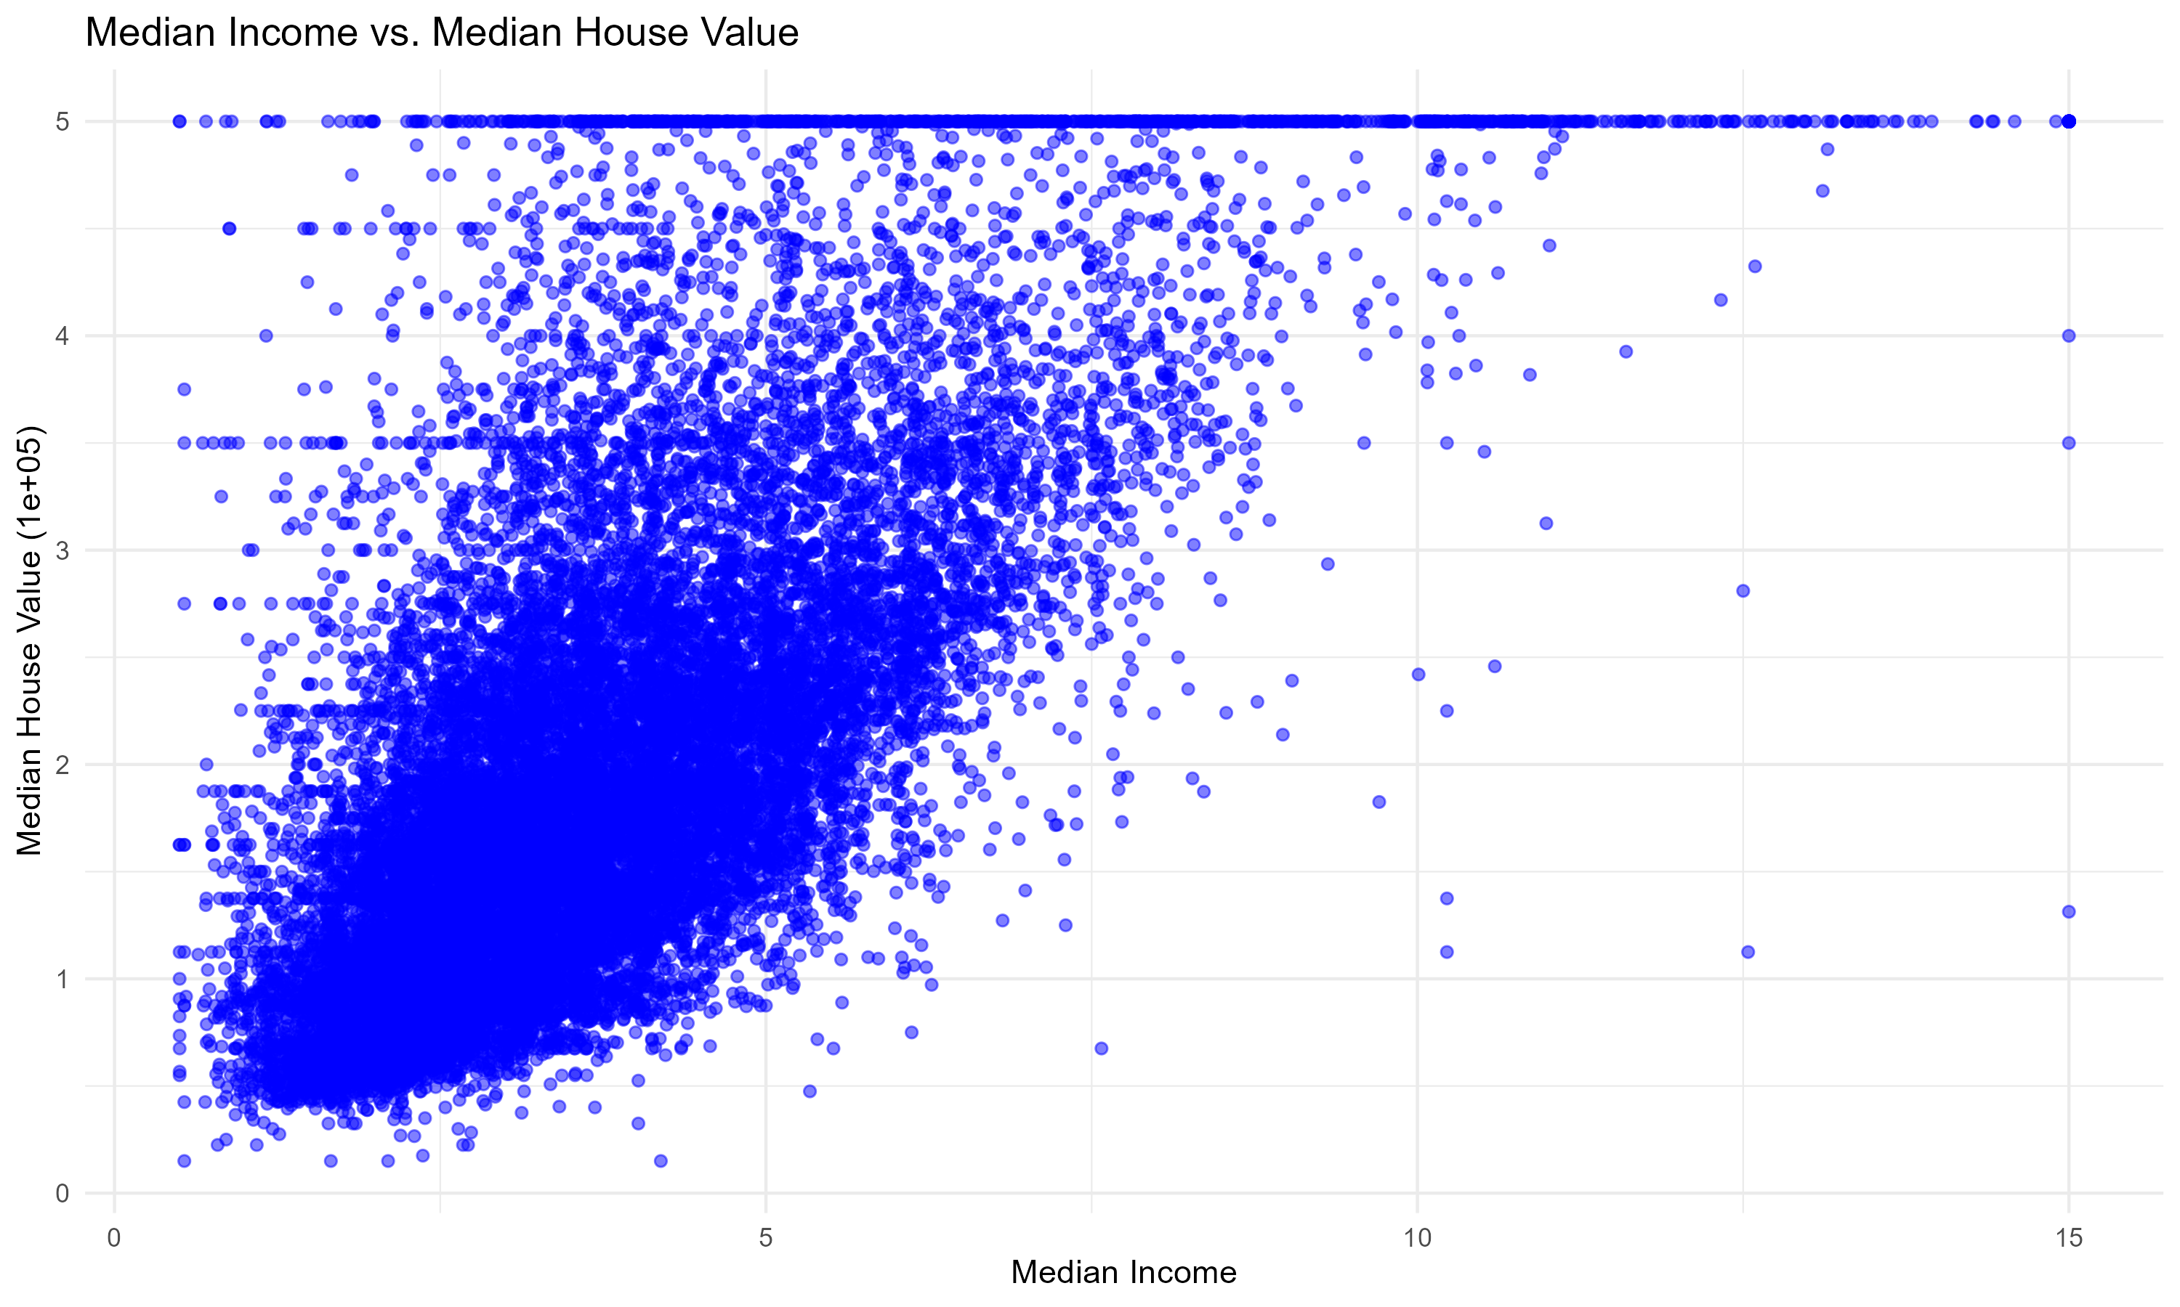
Scatter Plot of Median Income vs. Median House Value
Displays the relationship between median income and house value.
Higher income areas tend to have higher house values.
Helps understand economic factors driving house prices, assisting in assessing housing affordability.

Slide 7
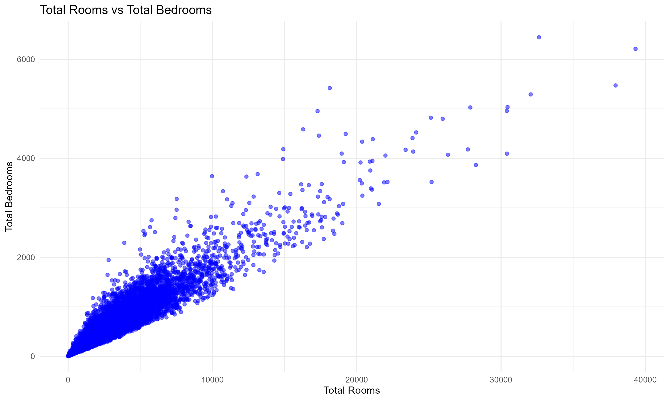
Total Rooms vs. Total Bedrooms
Shows the relationship between the total number of rooms and bedrooms.
A strong positive correlation indicates that more rooms generally mean more bedrooms.
Ensures housing projects meet market demand by balancing the number of rooms and bedrooms.

Slide 8
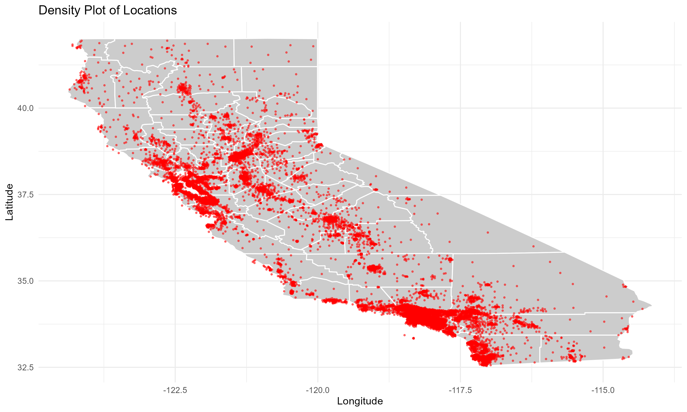
Density Plot of Locations
Displays the density of housing locations across California.
High-density areas are along the coast and in major cities.
Aids in urban planning and resource allocation for high-density areas.

Slide 9
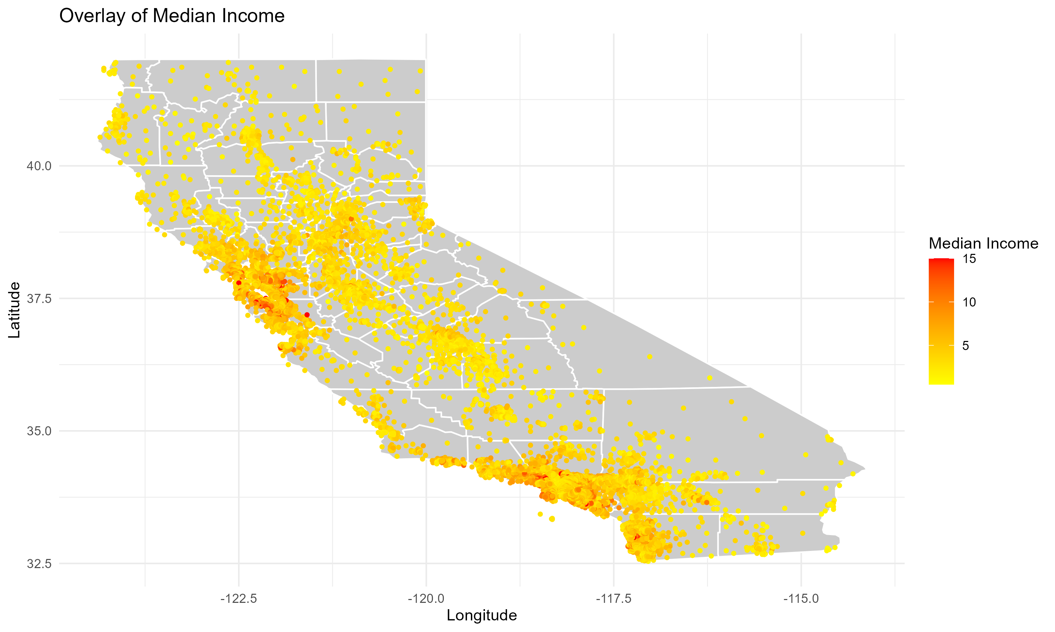
Overlay of Median Income
Overlays median income data on the geographic distribution of houses.
Higher income areas are near the coast and urban centers.
Identifies socioeconomic status, guiding policy decisions on housing affordability and development.

Slide 10
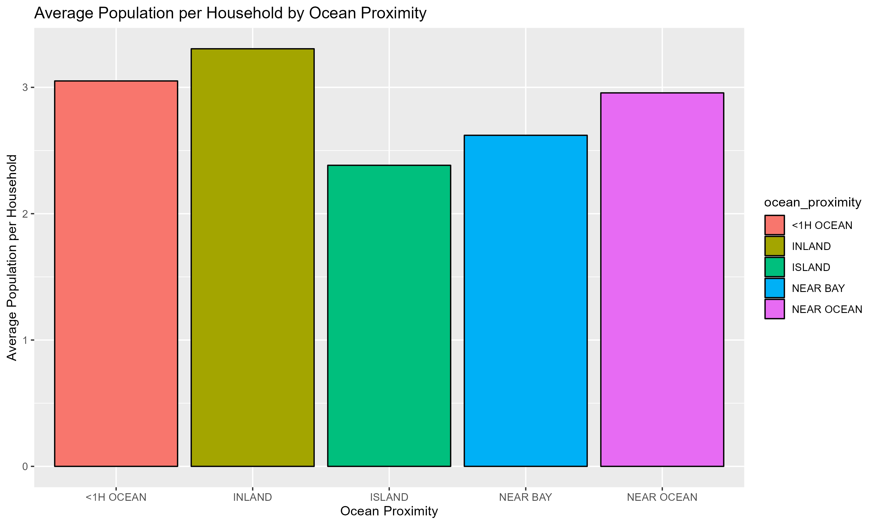
Average Population per Household by Ocean Proximity
Compares average population per household based on ocean proximity.
Inland areas have higher average populations per household.
Informs community service and infrastructure planning for larger households.

Slide 11
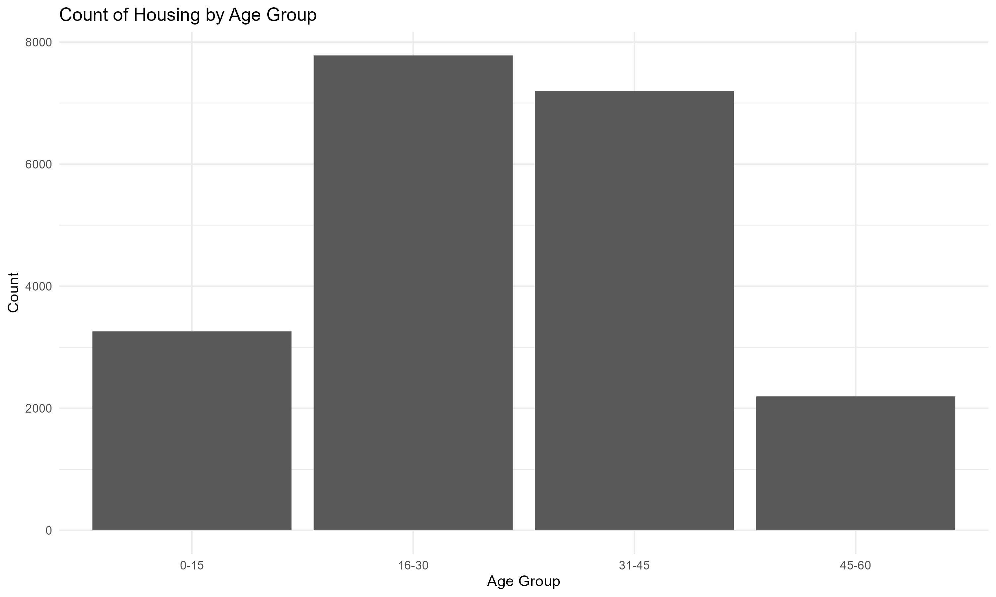
Bar Chart of Age Group
Shows the count of houses by age group.
Most houses are in the 16-30 and 31-45 age groups, indicating newer properties.
Guides maintenance planning and renovation projects based on housing age.

Slide 12
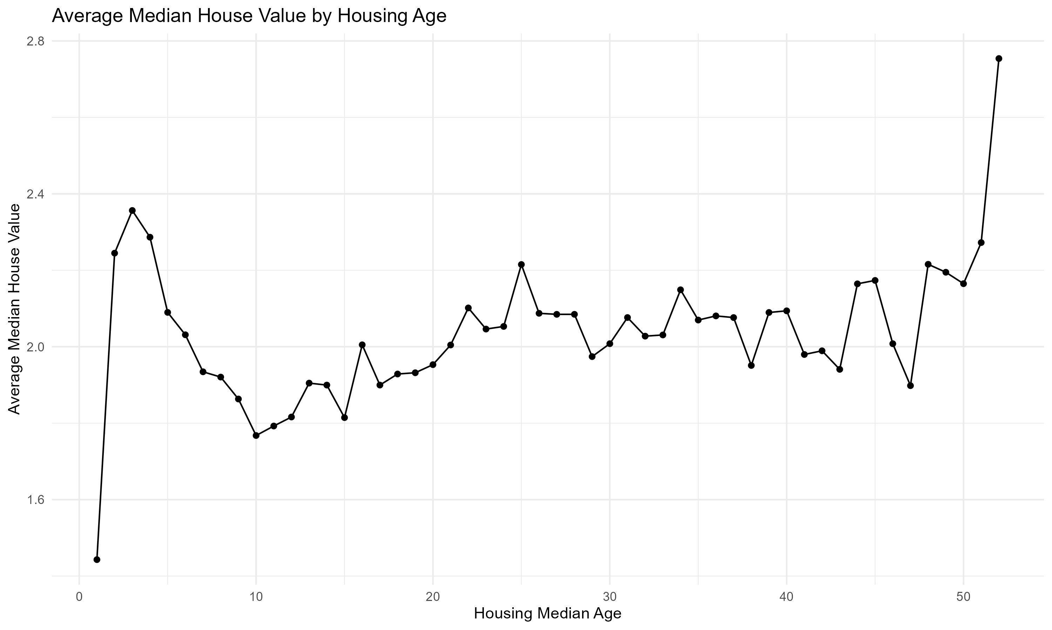
Line Chart of Average Median House Value by Housing Age
Shows average house value by age of the house.
House values generally decrease as housing age increases.
Assists in assessing property depreciation and planning renovations to maintain value.

Slide 13
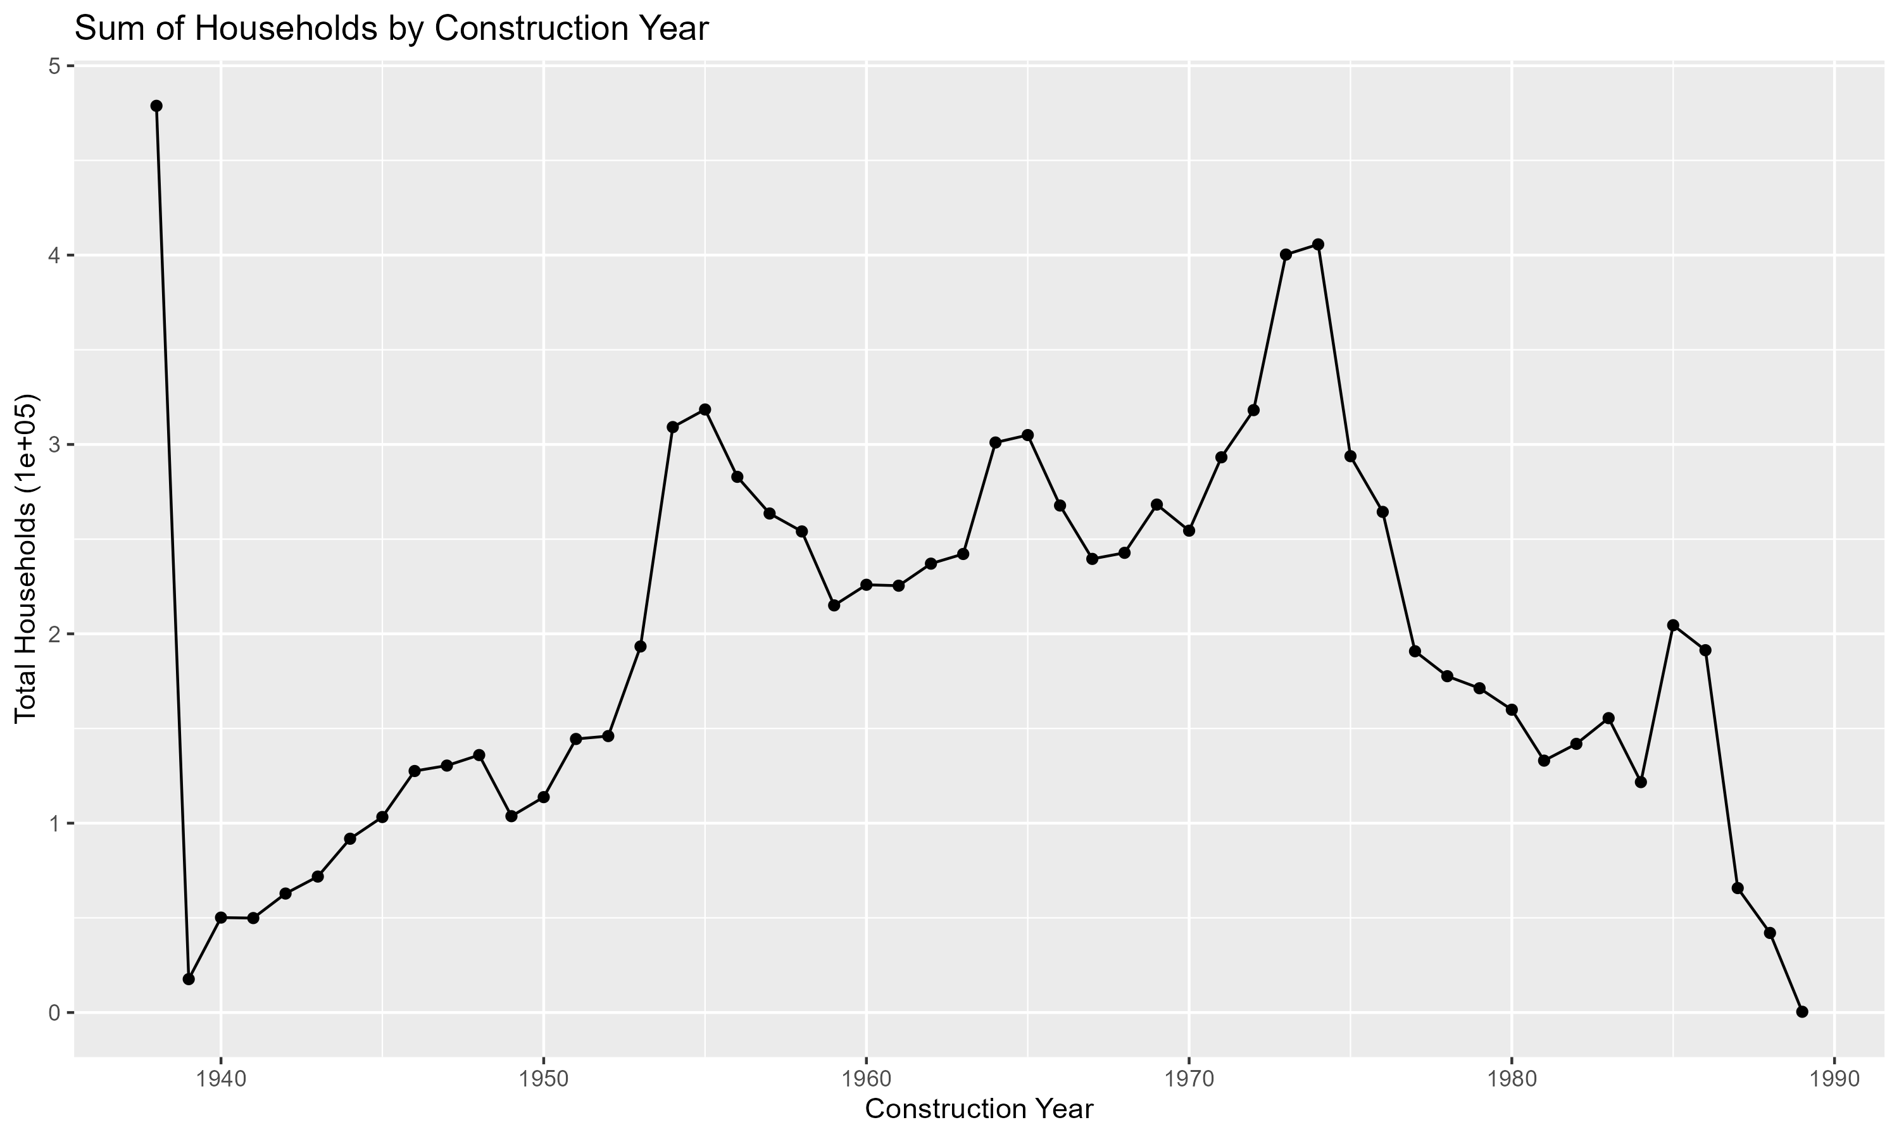
Line Chart of Sum of Households by Construction Year
Shows the sum of households by construction year.
Significant development occurred between 1950 and 1980, with peaks in the 1950s and 1970s.
Helps understand historical housing trends and plan future projects based on past growth.

Slide 14
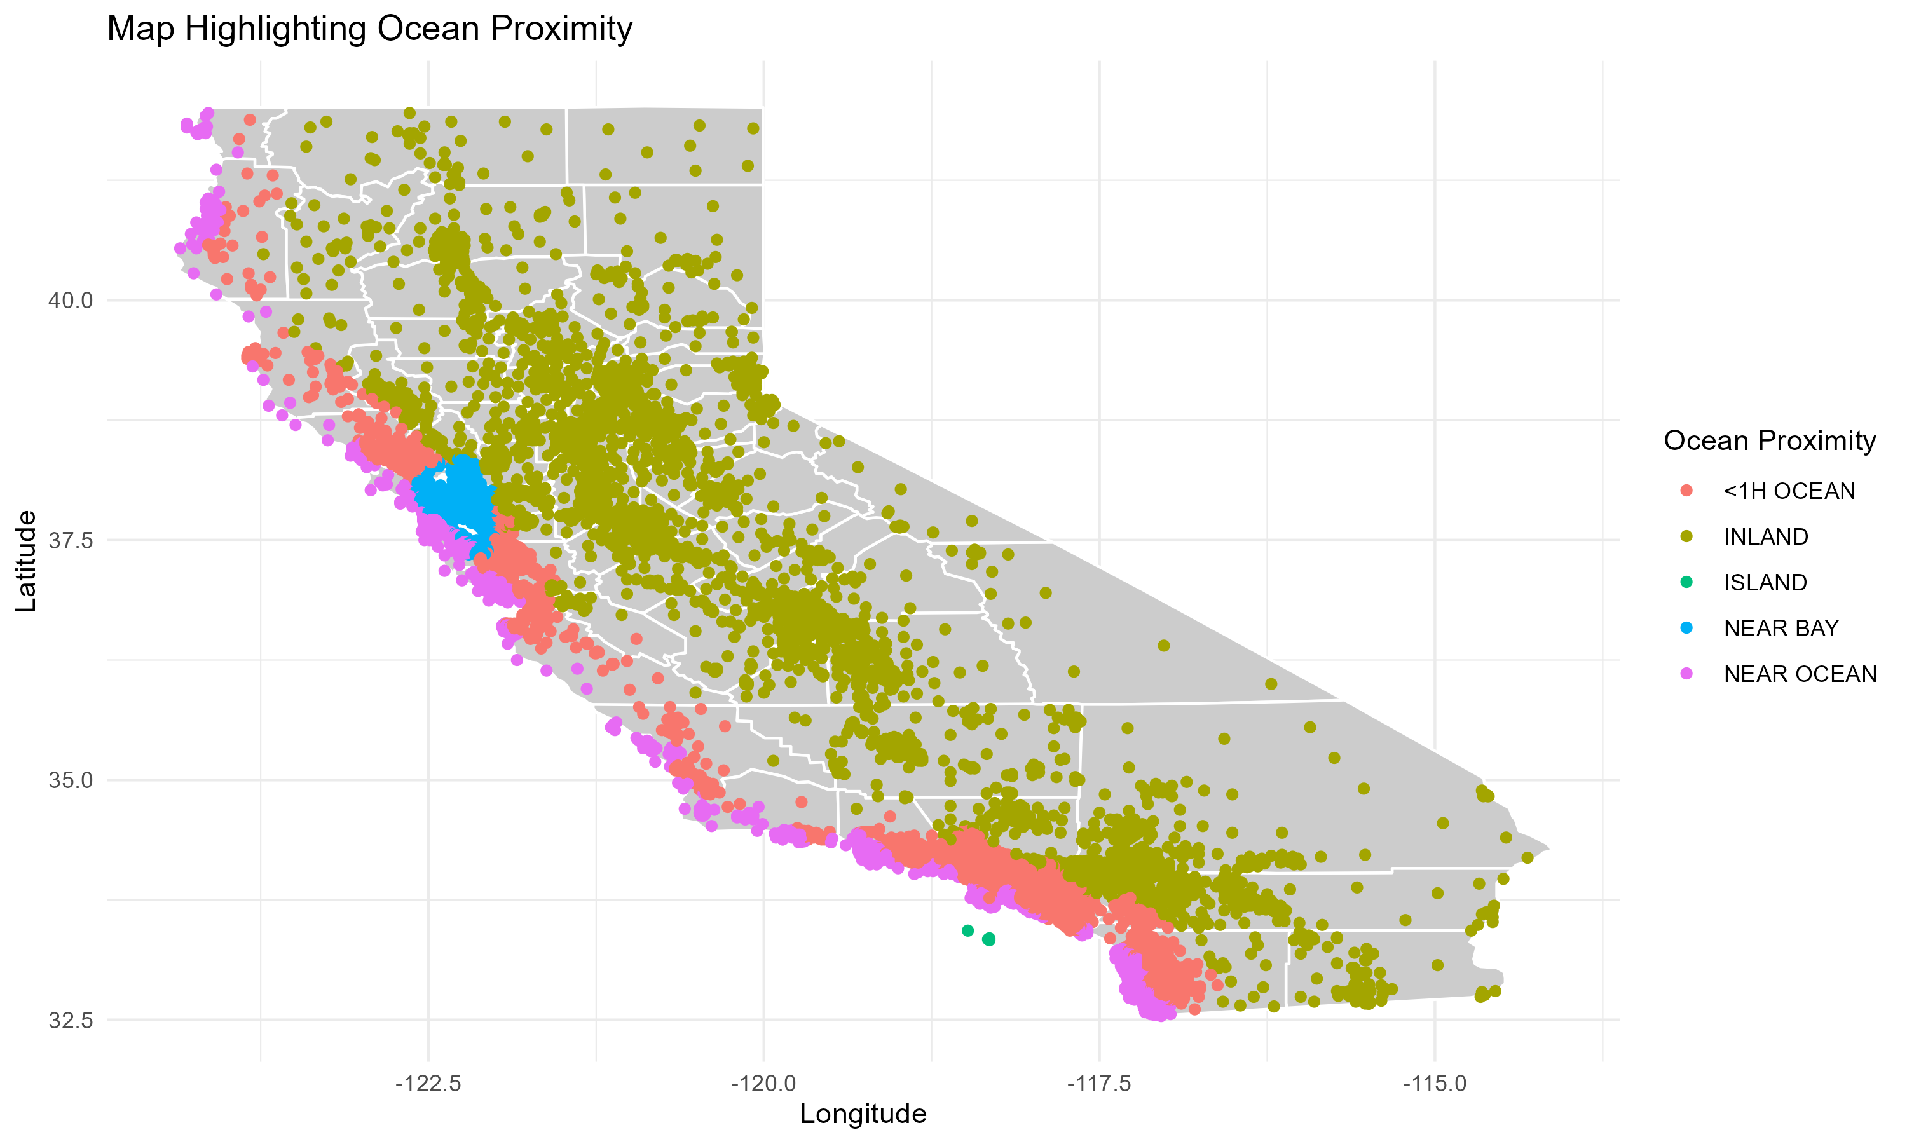
Map Highlighting Ocean Proximity
Static Description: Highlights houses based on their ocean proximity. Properties near the ocean are clustered along the coast.
Interactive Description: Users can zoom in on specific regions and view detailed proximity data. Hovering over points provides additional information about each property.
Enhances geographic analysis, making it easier to identify clusters of coastal and inland properties for targeted real estate marketing and development planning.

Slide 15
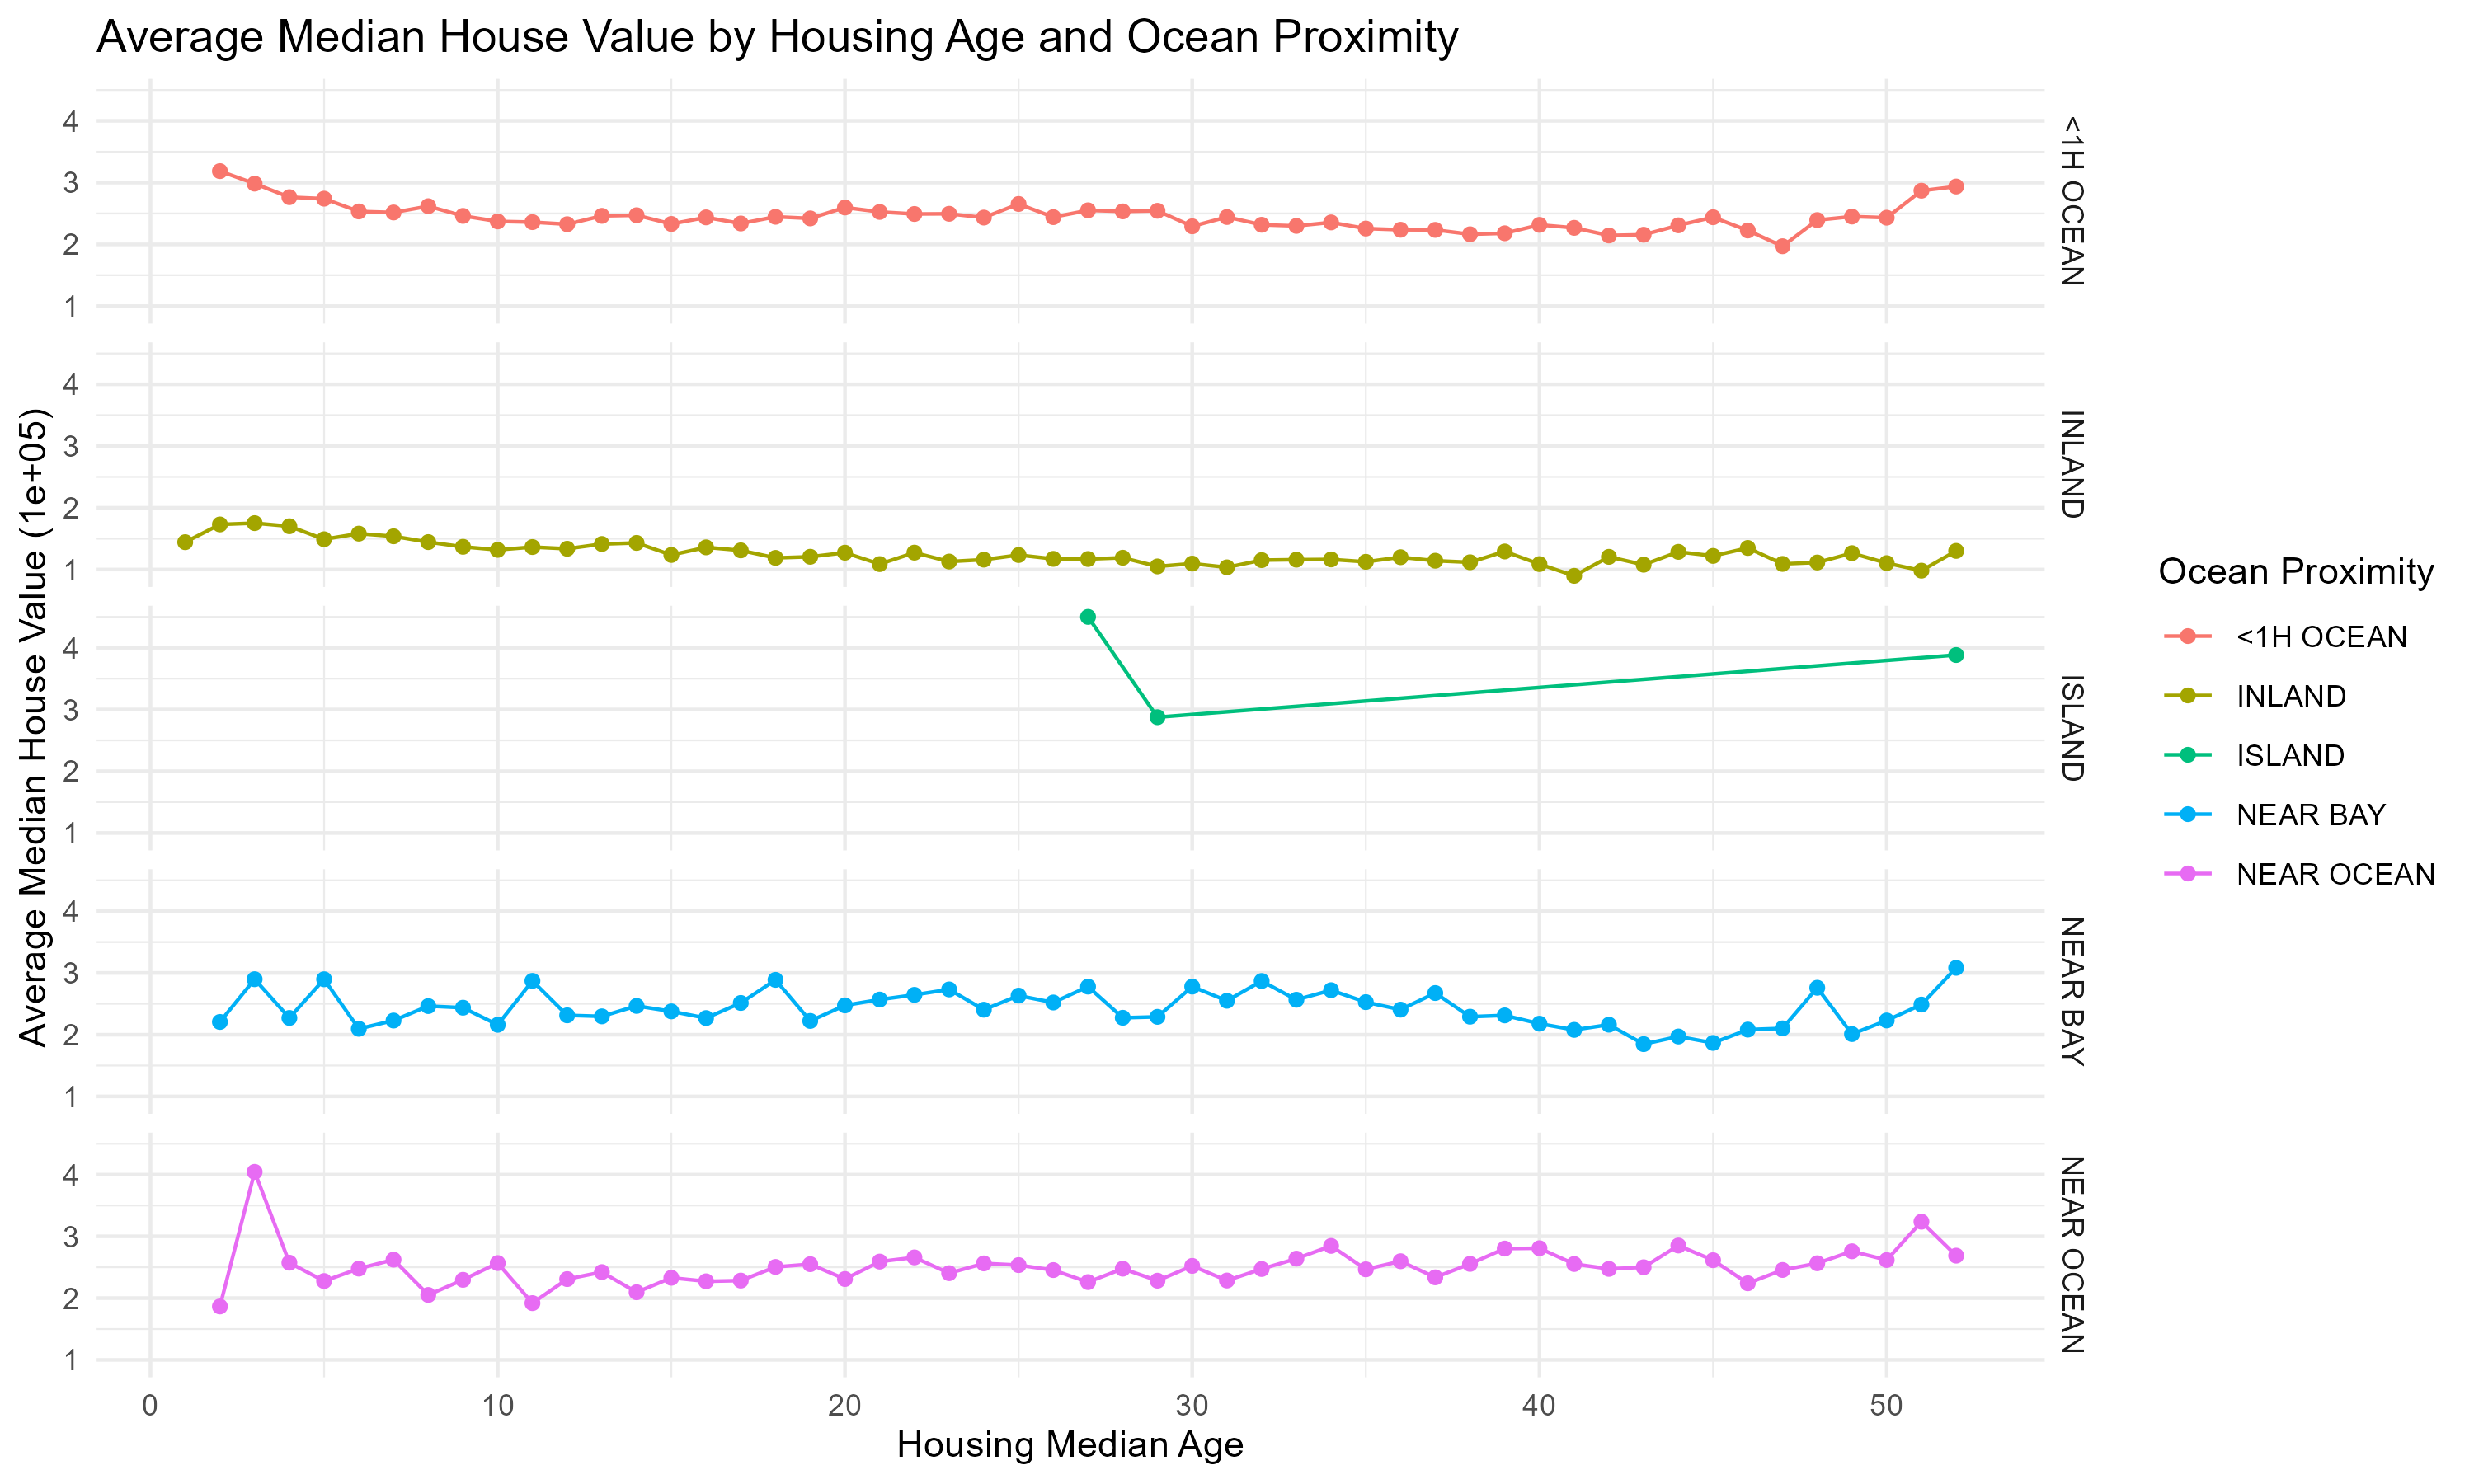
Line Chart of Average Median House Value by Housing Age and Ocean Proximity
Static Description: Shows average house values by housing age and ocean proximity. Island properties have higher values regardless of age.
Interactive Description: Users can filter by ocean proximity and see how house values change over different housing ages. Detailed tooltips provide context-specific information.
Helps investors and policymakers understand the impact of housing age and ocean proximity on property values, guiding investment decisions.

Slide 16
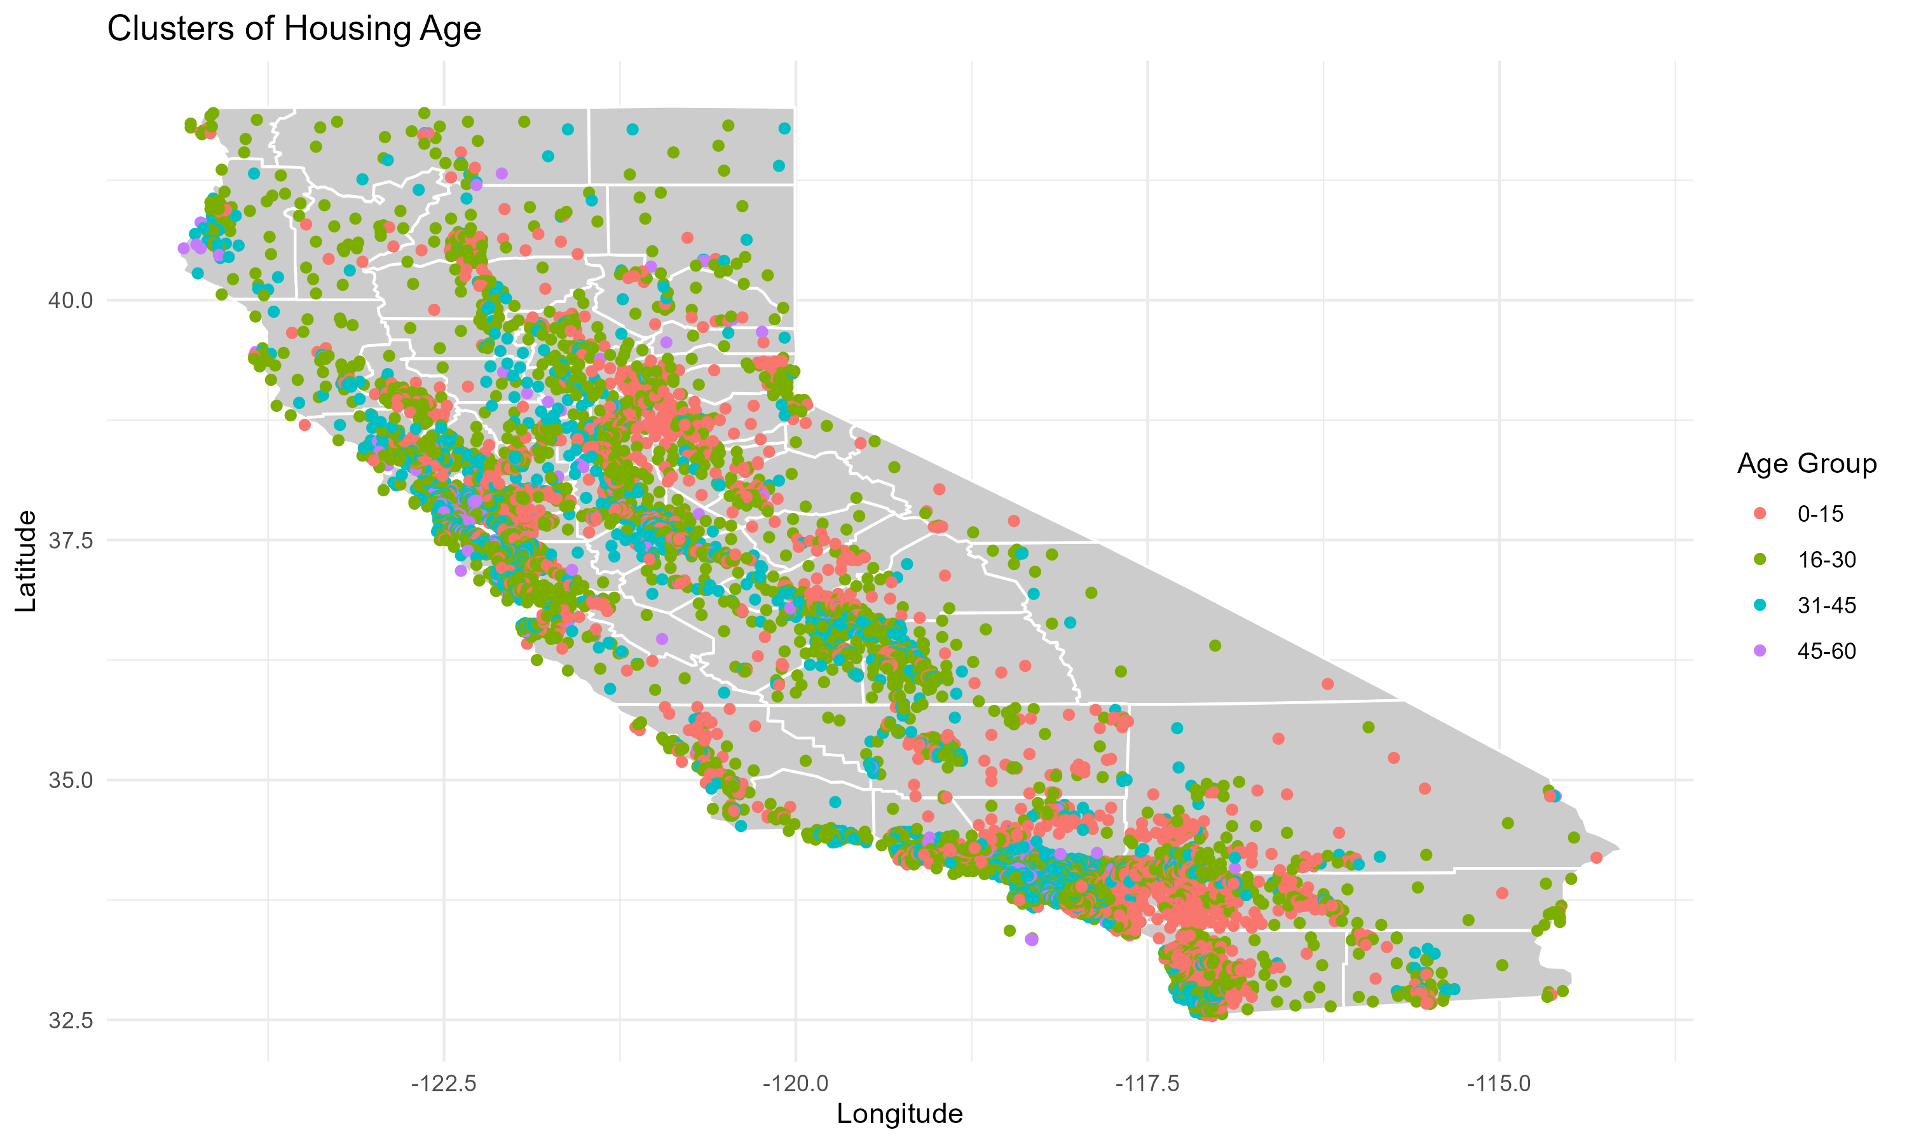
Map of Clusters of Housing Age
Static Description: Shows clusters of houses based on their age. Older houses are more evenly distributed.
Interactive Description: Users can explore different regions by zooming and panning, with detailed tooltips providing additional information.
Facilitates urban renewal projects and resource allocation by highlighting clusters of older and newer housing stock.

Slide 17
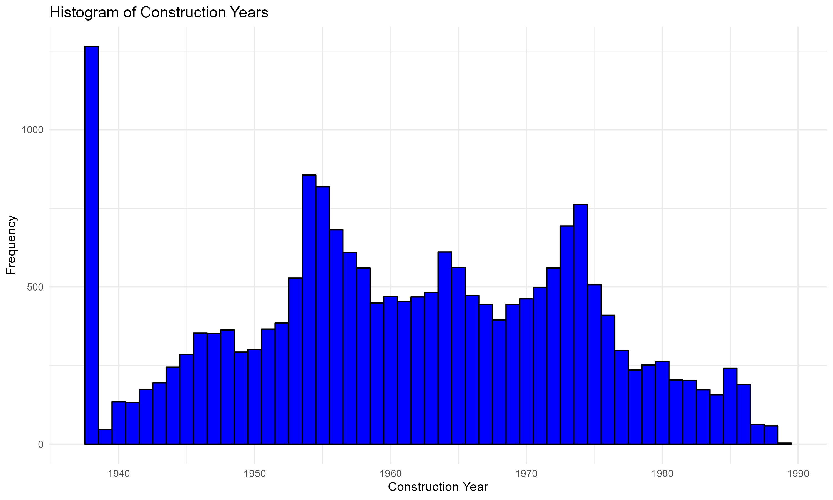
Histogram of Construction Years
Static Description: Shows the distribution of construction years for the houses. There were significant construction booms in the 1950s, 1960s, and 1970s.
Interactive Description: Users can zoom in on specific time periods to examine construction trends. Detailed tooltips provide additional context about the number of houses built in each year.
Helps in assessing the age distribution of housing stock and planning for future construction projects.

Slide 18
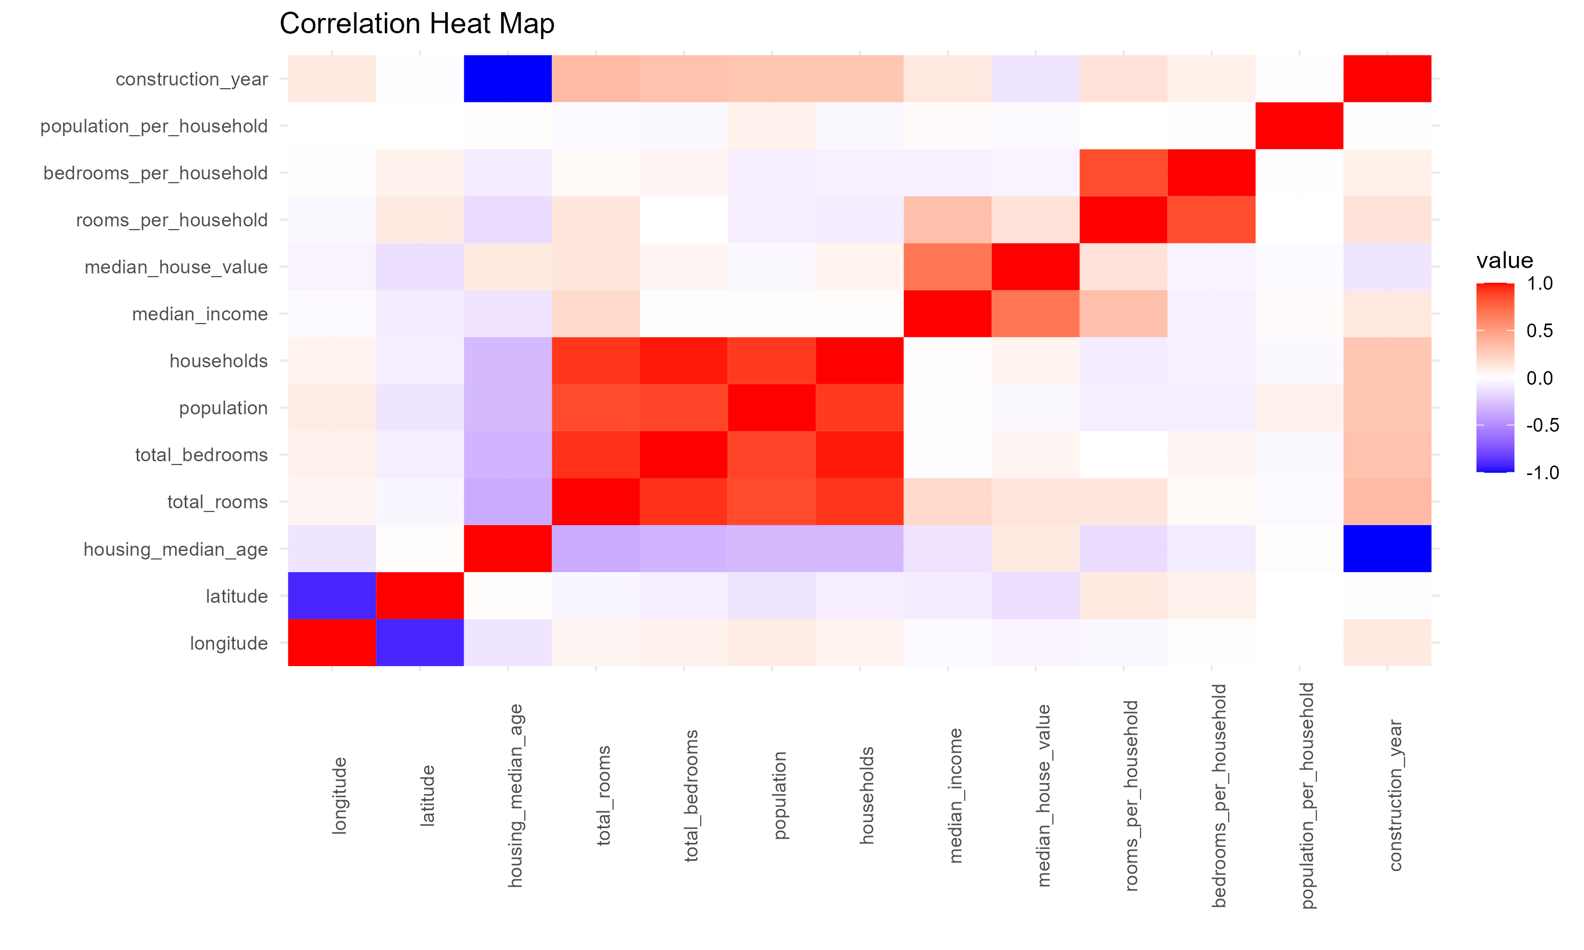
Correlation Heat Map
Static Description: Shows the correlation between different numerical features in the dataset.
Interactive Description: Users can hover over heat map cells to see exact correlation values between features. Clicking on cells provides additional insights into the relationships.
Identifying correlations helps in building predictive models and understanding the relationships between different housing features.

Slide 19
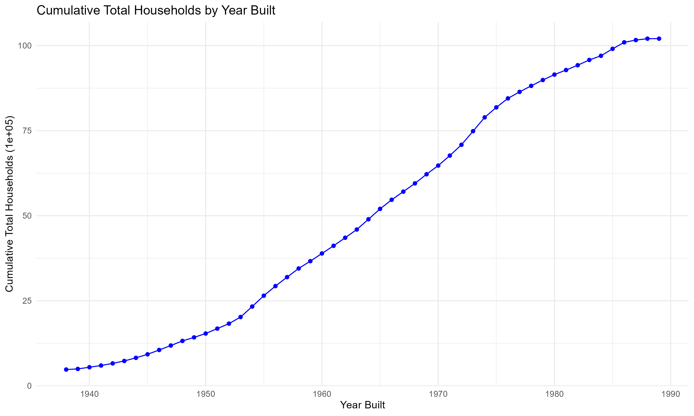
Cumulative Total Households by Year Built
Static Description: Shows the cumulative number of households built over time.
Interactive Description: Allows users to explore the cumulative growth of households over time with detailed tooltips providing context-specific information.
Helps in understanding long-term housing growth trends and planning for future housing development.

Slide 20
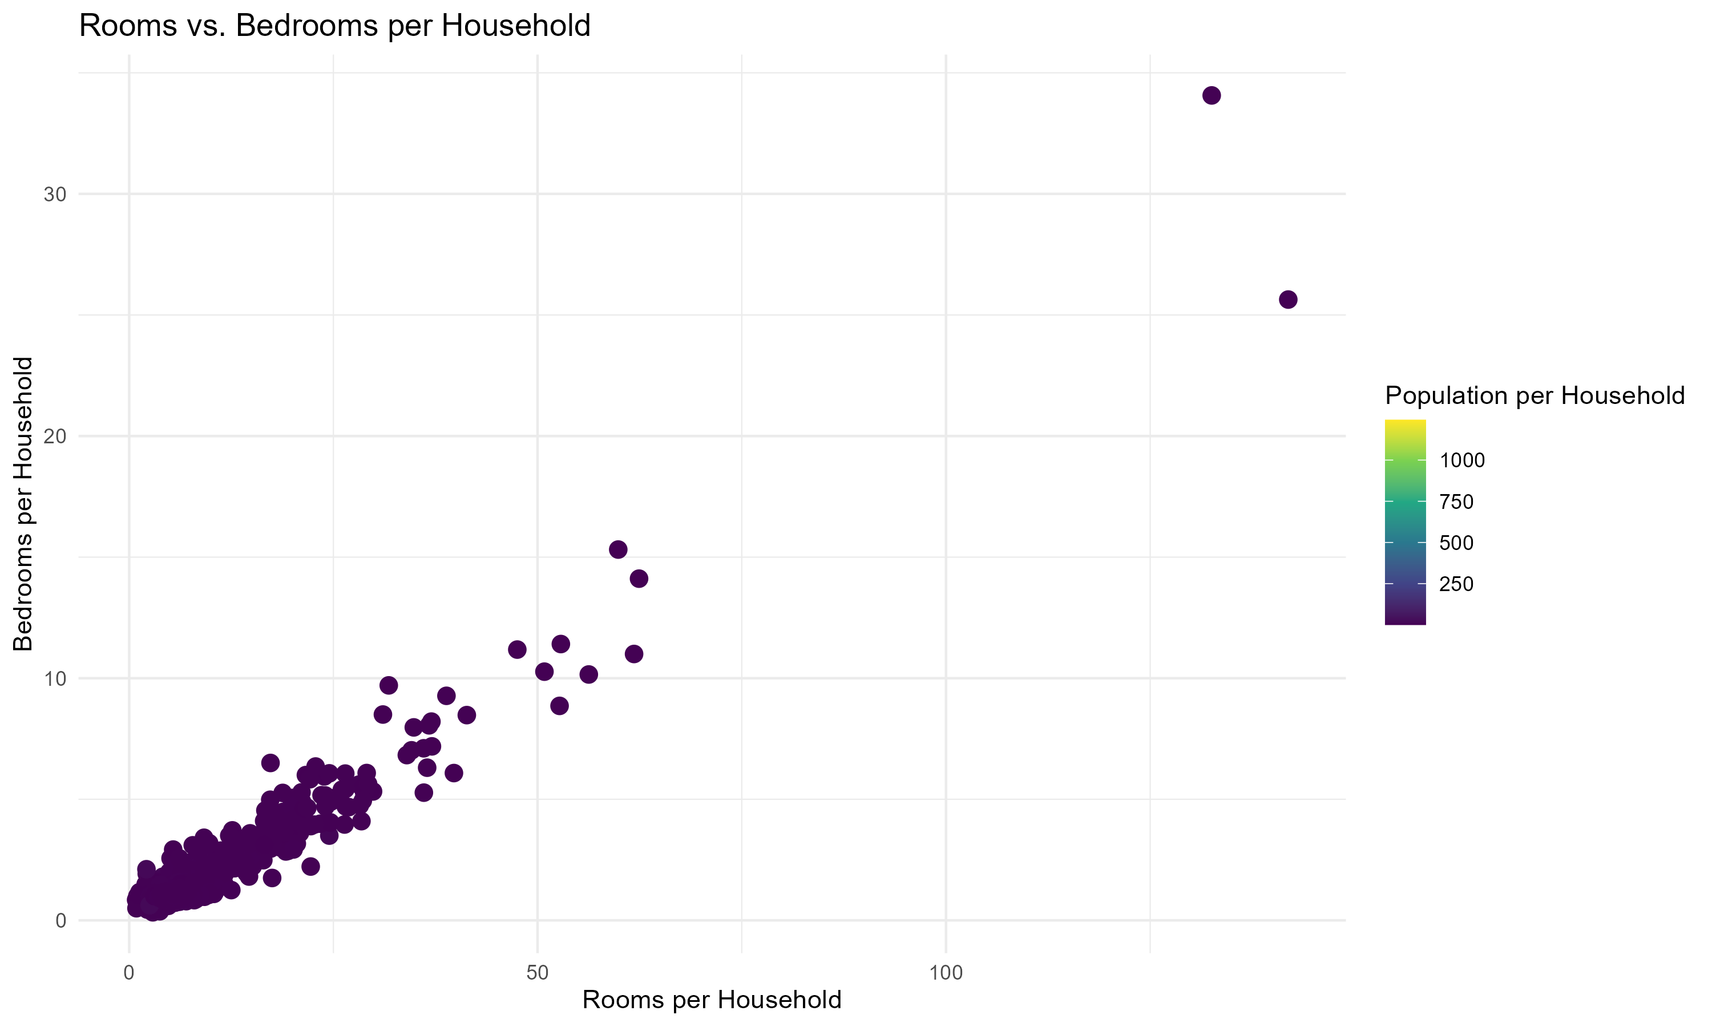
Rooms vs. Bedrooms per Household
Static Description: Shows the relationship between rooms per household and bedrooms per household. There is a clear positive relationship.
Interactive Description: Provides a detailed view of the relationship between rooms and bedrooms per household, with the ability to zoom in on dense areas. Detailed tooltips provide additional context.
Ensures housing projects meet market demand by balancing the number of rooms and bedrooms.

Slide 21
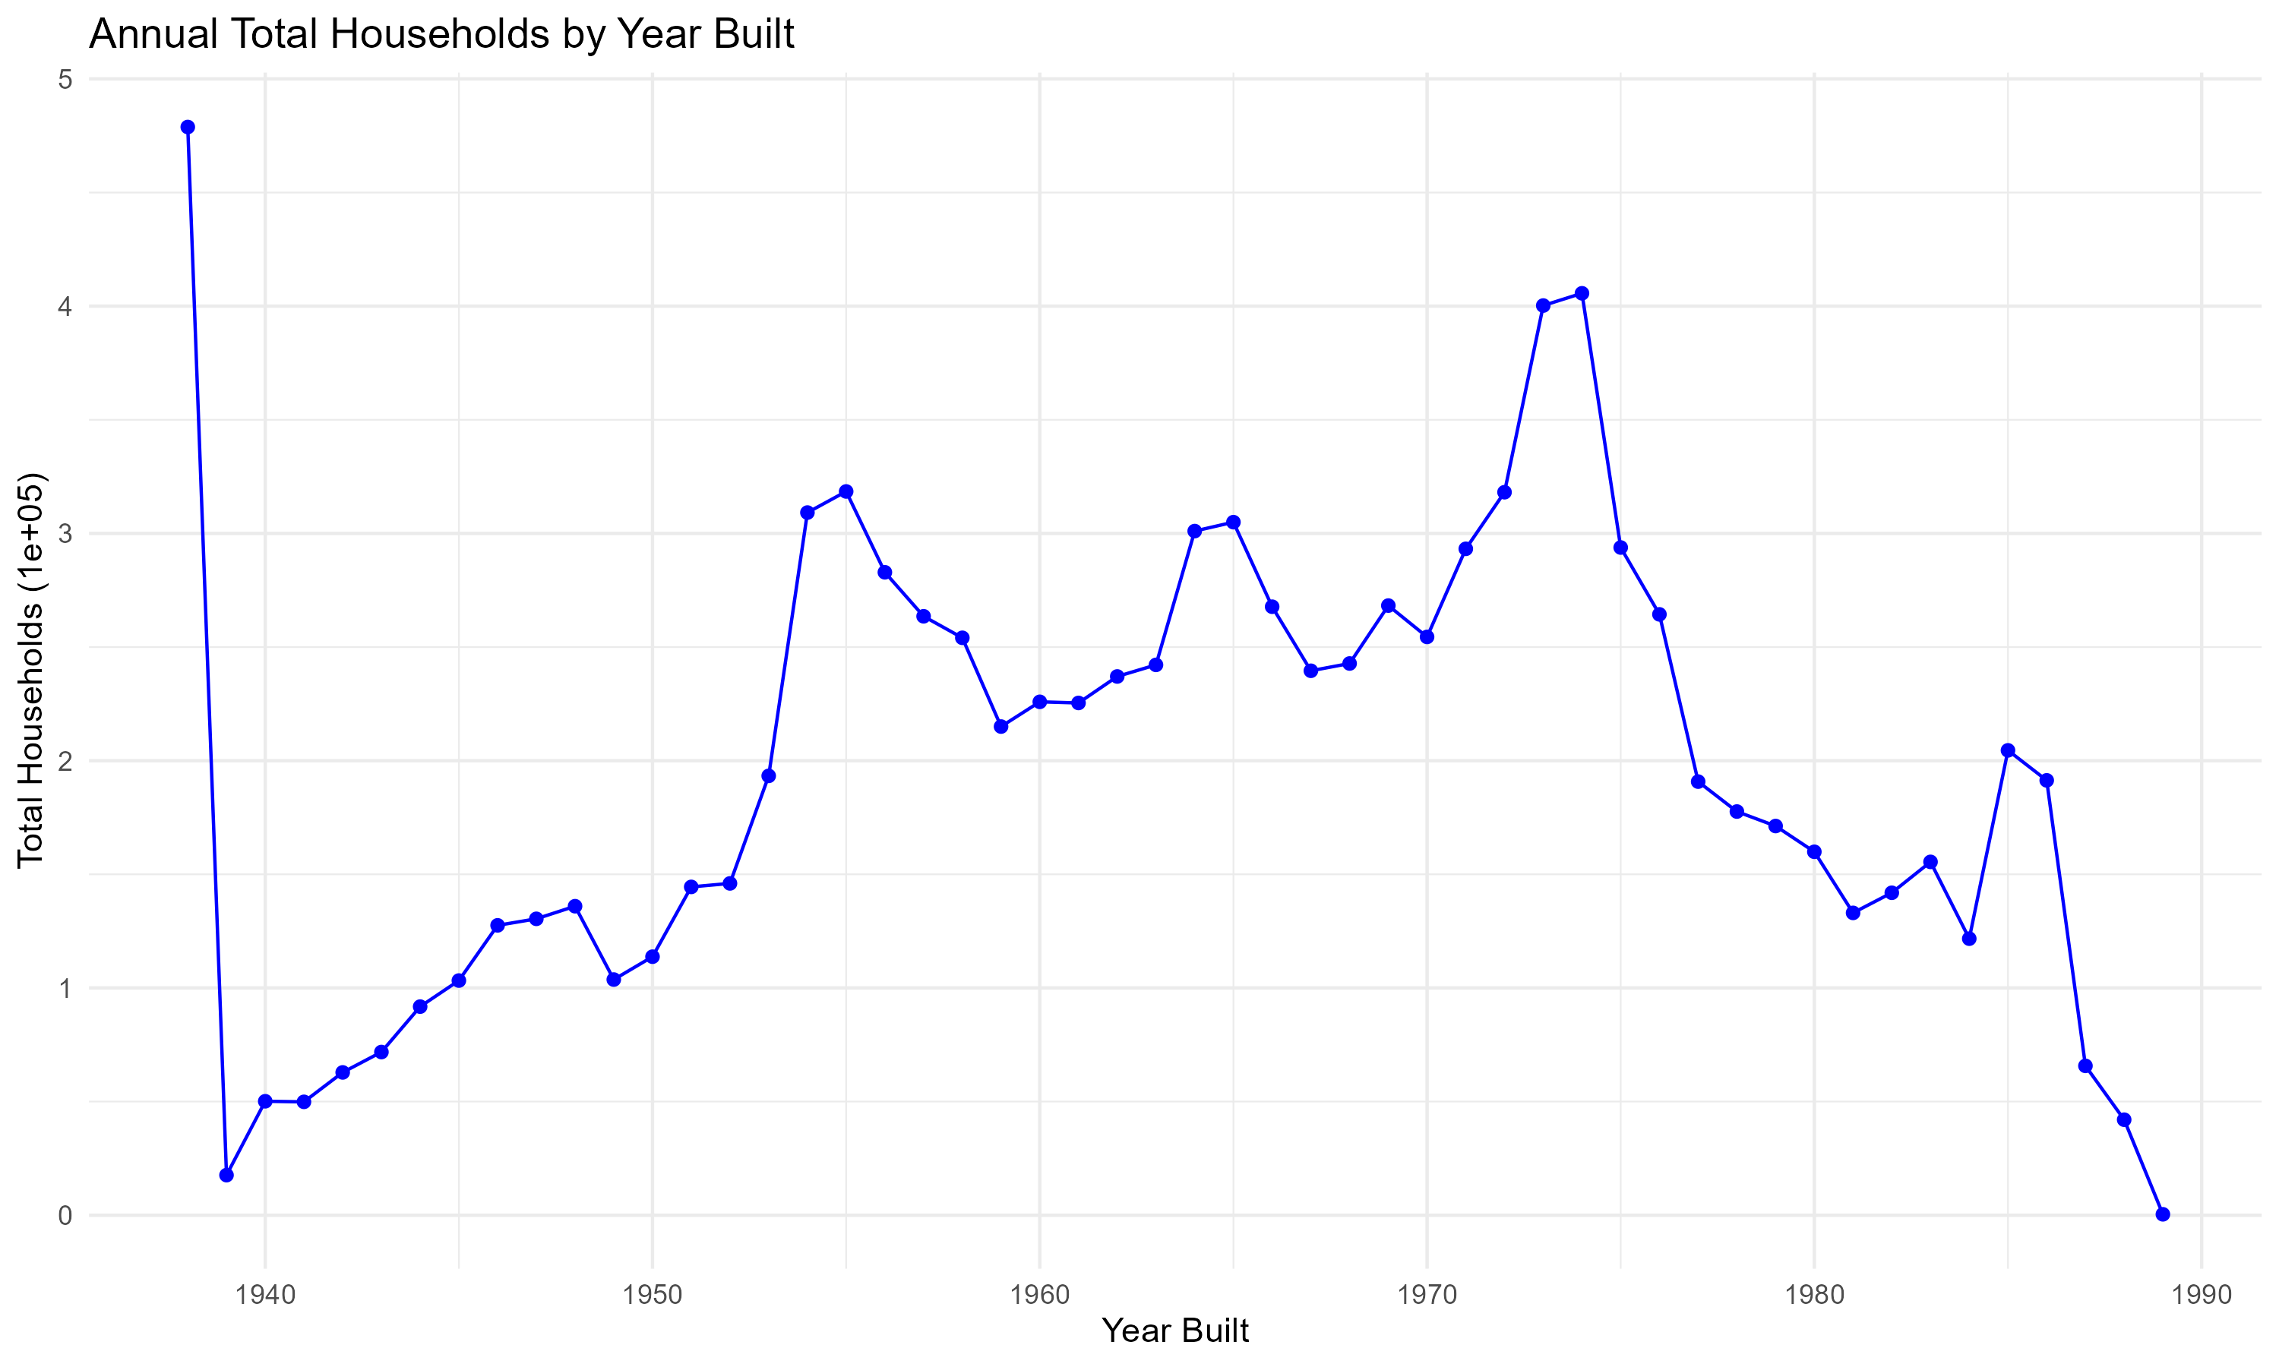
Annual Total Households by Year Built
Static Description: Shows the annual total number of households built.
Interactive Description: Users can interactively examine annual construction trends, zooming in on specific years of interest. Detailed tooltips provide additional context.
Understanding annual construction trends helps in forecasting future housing needs and planning for sustainable development.

Slide 22
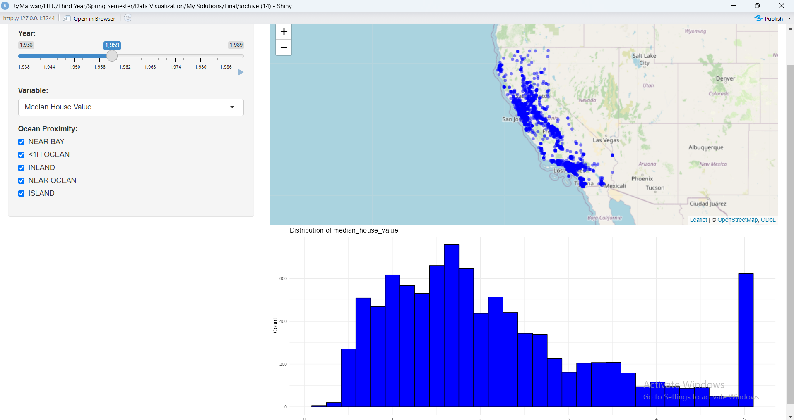
Shiny App Overview
An interactive platform for exploring the distribution of houses built over time in California on a map, and the distribution of other variables on a histogram.
Features:
Selection: Users select specific years using a slider, specific variables using a dropdown menu, and ocean proximity using checkboxes.
Navigation: The map allows panning and zooming.
Filtering: Data dynamically updates based on selected year, along with the option to choose a variable using the dropdown menu along with the ocean proximity checkboxes.
Change Over Time: Animation shows development over time.
Focus and Context: Circle markers provide detailed views with geographic context.
Offers insights into housing development trends, aiding in planning and resource allocation for future projects.

